Slide 1



Economic Signal Mapper
Tracking Kenya’s Price Trends
A Data Science Tool for Economic Insight and Forecasting
Presented by Group 4

Slide 2
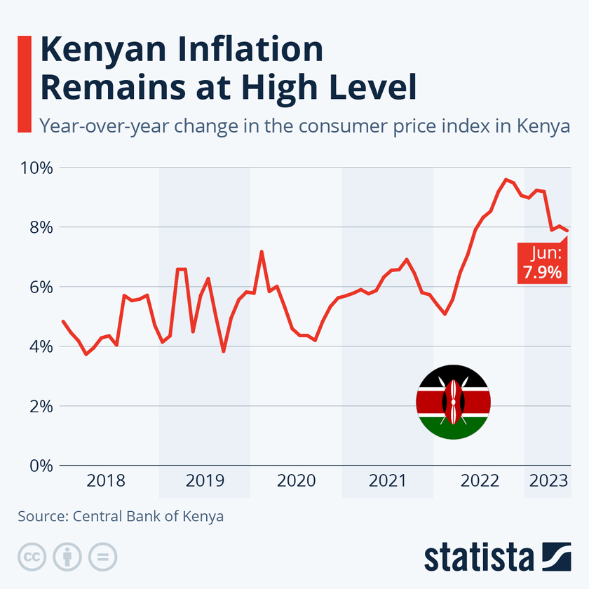

Problem Statement
Essential goods in Kenya (e.g., food, fuel) show frequent price shifts due to inflation, currency volatility, and global shocks.
Price data is often delayed and buried in PDFs, leaving citizens and policymakers without real-time tools for tracking and forecasting.
Project Goal: Build a tool to track, analyze, and forecast Kenya’s key price trends, empowering informed decision-making.

Slide 3
Project Objectives
🟢 Collect price data from sources like KNBS & online retailers
🟢 Clean and standardize the data for analysis
🟢 Visualize economic trends in a dashboard
🟢 Forecast future prices using machine learning
🟢 Alert users of anomalies (e.g., price spikes)
Output:
An interactive platform for tracking, analyzing, and forecasting essential prices in Kenya.

Slide 4

Model Pipeline Overview
01
02
03
04
05
Data Scrapping
Data Cleaning
EDA
Forecasting
Insights
Feature Engineering: Rolling averages, date features, price change rates
Forecasting: Applied ARIMA, Prophet, and LSTM models
Used MAE, MAPE, RMSE for comparison
Identified trends, seasonality, and pricing patterns.
Web scraped prices from online retailers.
Handled missing values, outliers; normalized pricing

Slide 5

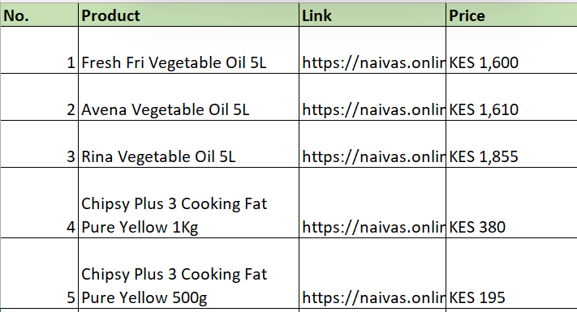
Data Sources
Online Supermarkets (Web Scraping)
Collected product prices from Kenya’s most frequented online retailers:
Naivas Online
Quickmart
Carrefour
Focused on essential items: food staples, household goods, personal care, etc.
Data format: scraped and structured into CSV for analysis.

Slide 6


Key Findings
Data Coverage:15 k daily price observations from Naivas, Carrefour & Quickmart
Price Distribution: Essentials (Oil, Dairy) have tighter range; Electronics exhibit high volatility
Seasonal Patterns: Monthly peaks aligned with major festivals (seen in seasonal component)
Anomaly Detection: Isolation Forest flagged ~3% of outliers, cleaned before modeling
Category Independence: Minimal inter‐category correlation (|r|<0.05), so each series is modeled separately
Exploratory Data Analysis

Slide 7
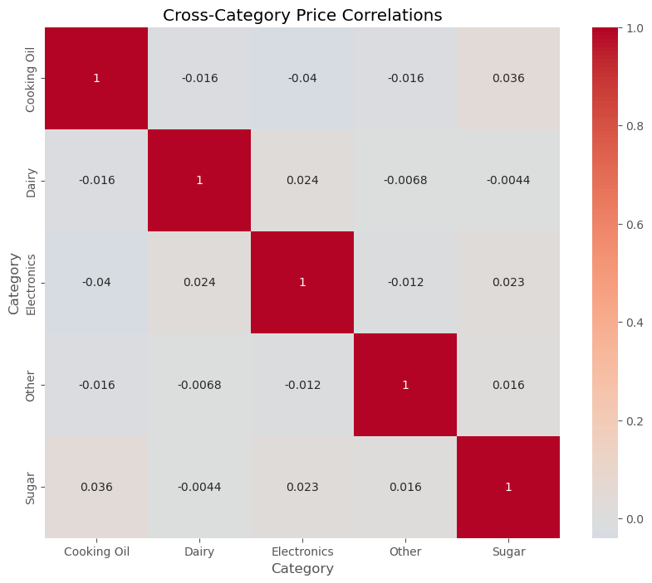
Cross-Category Correlation
Almost zero correlation between most categories (|r|<0.05) → prices move independently.
Cooking Oil & Sugar: slight positive link (r≈0.04) → shared supply / demand factors.
Electronics: effectively uncorrelated with all others (|r|<0.03) → forecast each category separately.

Slide 8
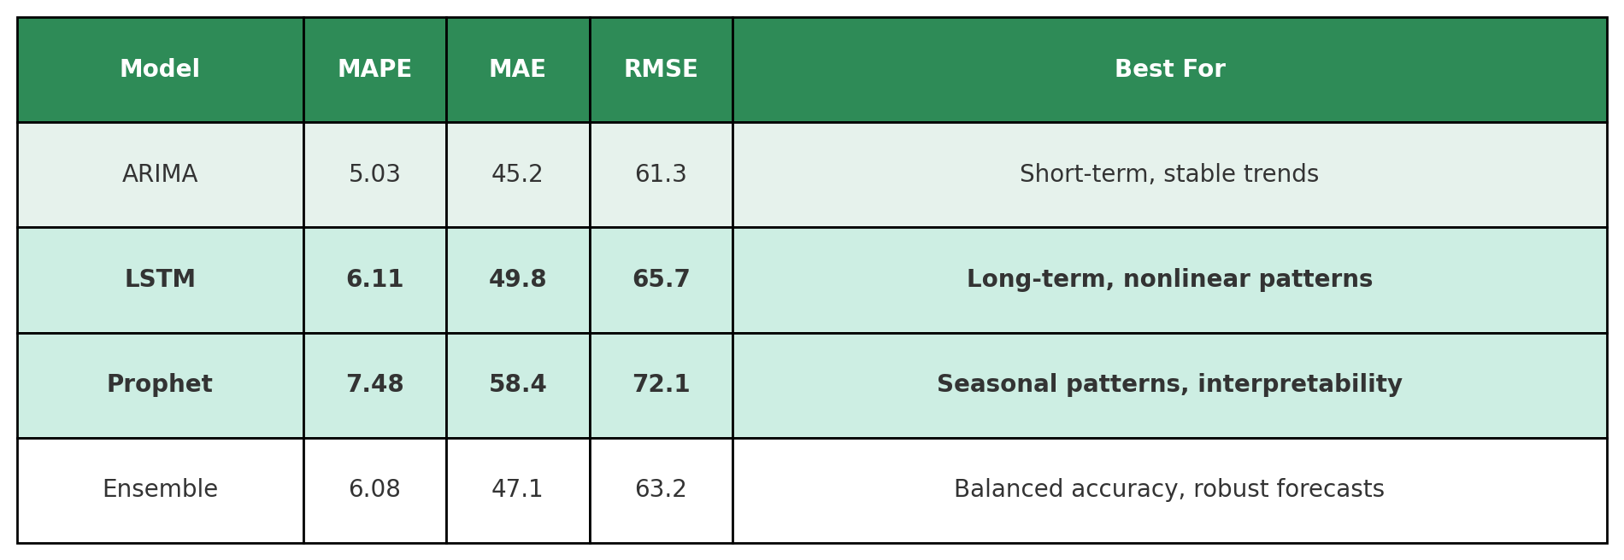
Forecasting Models Used
Model Evaluation Metrics Used
MAE (Mean Absolute Error), MAPE (Mean Absolute Percentage Error), RMSE (Root Mean Squared Error)

Slide 9
Training Model : LSTM
Why Not ARIMA or Prophet?
ARIMA: Slightly better accuracy, but limited to simple, stable patterns
Prophet: Higher error, better suited for seasonal data only
Key Reasons:
Handles Complexity: Captures nonlinear price trends and long-term dependencies
Performs Well: MAPE of 6.11% close to ARIMA, with strong generalization
Adaptable: Scalable across different product categories and dynamic markets
LSTM offers a strong balance between performance and flexibility, making it ideal for forecasting diverse and evolving price trends.

Slide 10
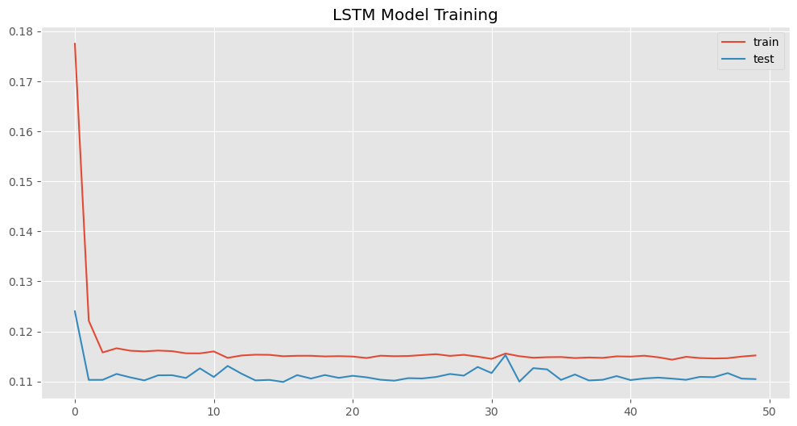
The chart shows the model’s “error” rate dropping sharply in the first few cycles, then settling at a steady, low level for both training (red) and testing (blue). This means the LSTM learned quickly and makes similarly small errors on new data, so it’s both fast and reliable without over-fitting.

Slide 11
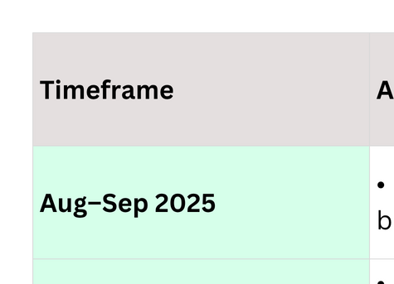
Timeline (Next Steps)

Slide 12


Recommendations
Deploy BeiWatch’s LSTM-powered forecasts into production
Build an interactive BeiWatch dashboard with live trends, confidence bands, and filters
Automate alerts when actual prices deviate >5% from forecasted values
Retrain the LSTM monthly and monitor MAPE/MAE for performance

Slide 13


For more
information
Have a look at our GitHub Repo:
BeiWatch Repo
CONNECT WITH US
Bernice Kigochi
Vanessa Wambui
Eric Otieno
Lilian Kwamboka
Tim Kirui

